Slide 1

Phase 1, Module 5: Advanced Data Structures
Khyber AI Systems Engineer (KASE)
Welcome to Module 5. As an AI engineer, you don't process one number at a time; you process millions. Today, we learn the four primary architectures for organizing mass data in Python: Lists, Tuples, Sets, and Dictionaries.
Presented By: Zaryab Ahmad

Slide 2
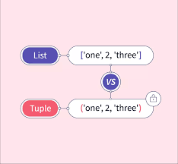
Lists vs. Tuples (The Memory Tradeoff)
Mutability vs. Efficiency
Lists []: Ordered and Mutable (changeable). Great for dynamic data that grows (e.g., a timeline of temperature readings in Swat).
Tuples (): Ordered and Immutable.
The AI Rule: Tuples use less RAM and process faster. We use Tuples for fixed AI configurations, like the shape of an image (224, 224, 3).

Slide 3
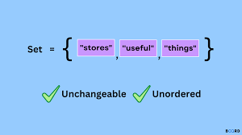

Sets (The Data Cleaner)
Instant Lookups & Deduplication
Sets {}: Unordered, unindexed, and strictly Unique.
Powered by Hash Tables $O(1)$time complexity).
AI Use Case: Cleaning massive, messy datasets.

Slide 4
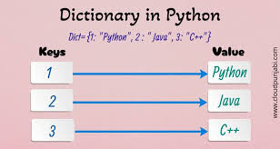

Dictionaries (The Language of the Web)
Key-Value Mapping & JSON
Dicts $\{"key": value\}:$Unordered, mutable, indexed by keys.
The Golden Rule: Python Dictionaries map perfectly to JSON (JavaScript Object Notation).
AI Use Case: APIs, Model Hyperparameters, and Agentic Handoffs.

